Slide 1
Digital Business and E-Commerce Management
Lesson 2
Marketplace Analysis for E-commerce

Slide 2
Marketplace analysis for E-commerce
At the end of this lesson, you will be able to:
Complete an online marketplace analysis to assess competitor, customer, and intermediary use of the Internet as part of strategy development
1
Identify the main business and marketplace models for electronic communications and trading
2
Evaluate the effectiveness of business and revenue models for online businesses
3

Slide 3
Activity 2.1
Refer to your book for Activity 2.1

Slide 4

Online Market Place Analysis
Understanding the online elements of an organization’s environment is a key part of situation analysis for digital business strategy development.
There is also a need for a process to continually monitor the environment, which is often referred to as environmental scanning.

Slide 5
Online Market Place Analysis
Situation Analysis
Collection and review of information about an organization’s external environment and internal processes and resources in order to inform its strategies.
Environmental Scanning and Analysis
The process of continuously monitoring the environment and events and responding accordingly.

Slide 6
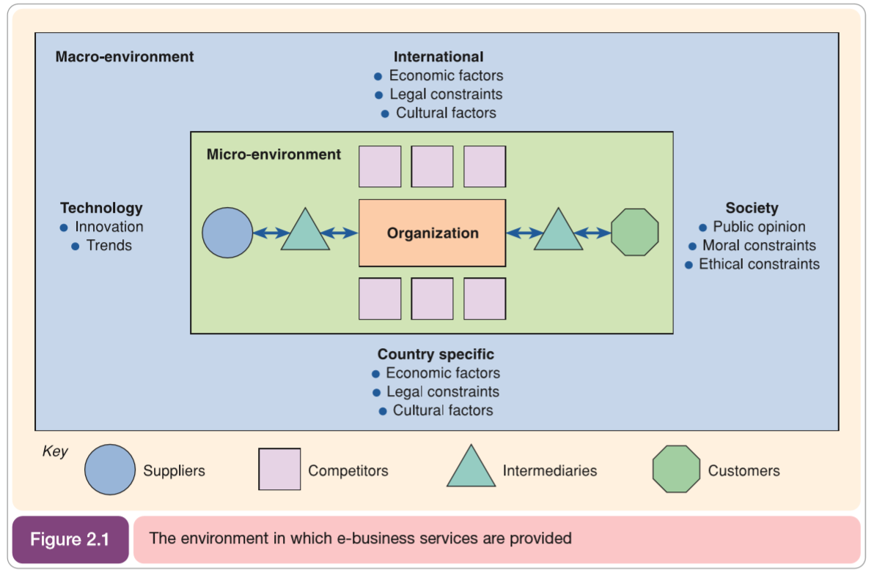
Online Market Place Analysis

Slide 7
Online Marketplace Analysis
Knowledge of the opportunities and threats presented by these marketplace changes is essential to those involved in defining business, marketing and information systems strategy.

Slide 8
Activity 2.2
Refer to your book for Activity 2.2

Slide 9
Online Marketplace Analysis
Analysis of the online marketplace or ‘marketspace’ is a key part of developing a long-term e-business plan or creating a shorter-term digital marketing campaign.
Completing a marketplace analysis helps to define the main types of online presence that are part of a ‘click ecosystem’ which describes the consumer behavior or flow of online visitors between search engines, media sites and other intermediaries to an organization and its competitors.

Slide 10
Online Market Place Analysis
Click Ecosystem
Describes the customer behaviour or flow of online visitors between search engines, media sites, other intermediaries to an organizations and its competitors
Online Market Ecosystem
Connects websites through data exchange, giving opportunities to enhance the customer experience and extend their reach and influence.

Slide 11
Online Market Place Analysis
Online Market Ecosystem
Major online players such as Facebook, Google, Salesforce have developed their own infrastructure or online market ecosystem.
For example, Facebook has developed the Facebook platform API to enable exchange of data between websites and application, including mobile apps.
Analysing the impact of different ecosystems on online consumer behaviour or customer journeys is, today, as important as observing their physical behaviour in the real world.

Slide 12
Activity 2.3
Refer to your book for Activity 2.3

Slide 13
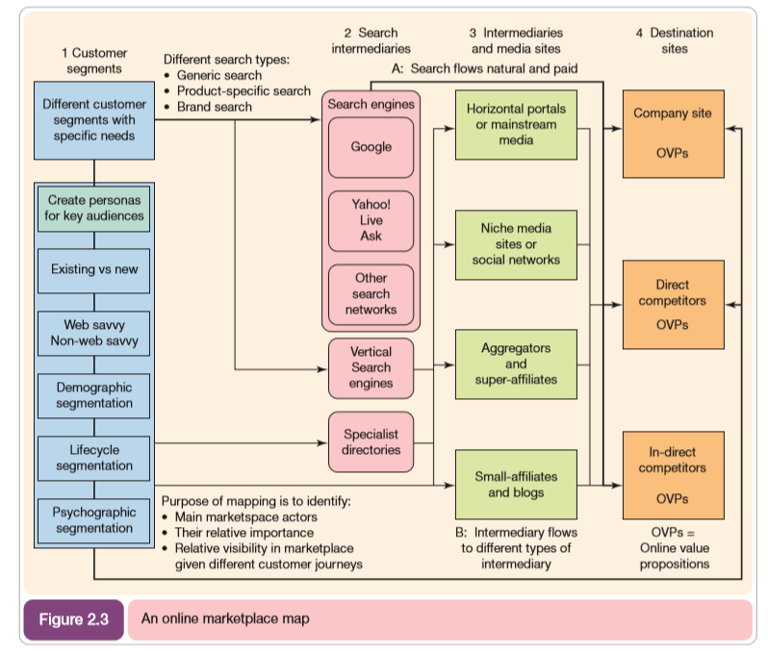

Slide 14
Online Marketplace Analysis
Customer Segments
Online media consumption
Search Intermediaries
Main search engines
Google, Yahoo and etc.
Intermediaries, Influencers, media sites
Aggregators
Influencer
Destination Sites
Generate Visitor
Buyer behaviour
Content experiences
Online Value Proposition

Slide 15
Activity 2.4
Refer to your book for Activity 2.4

Slide 16
Online Marketplace Analysis
Service | Usage
Google Tools - Mainly included within their AdWords services | Google is one of the best sources of accurate tools for marketplace analysis including: Placement tool Google Trends Keyword planner
Alexa - Free tool but not based on representative sample | Free service owned by Amazon which provides traffic ranking of individual sites compared to all sites.
Hitwise - Paid tool | Paid service available to some countries to compare audience size and search and site usage.
Nielsen - Paid tool, free data on search engines and intermediaries available from press release section | Panel service based on at-home and at-work users who have agreed to have their web usage tracked by software
Research tools for assessing your digital marketplace

Slide 17
Online Marketplace Analysis
Service | Usage
ComScore Paid Tool Free data on search engines and intermediaries available from press release sections | A similar service to Netratings but focusing more to the US and UK. A preferred tool for media planners
Google Analytics | Free and paid-for service which provide insights into website audience behaviour
SmartInsights Digital Marketing Statistics | A regularly updated compilation of statistics including the top 10 recommended statistics sources
Forrester Paid search service Some free commentary and analysis within blogs | Offers reports on Internet usage and best practice in different vertical sectors such as financial service, retail and travel
Research tools for assessing your digital marketplace

Slide 18
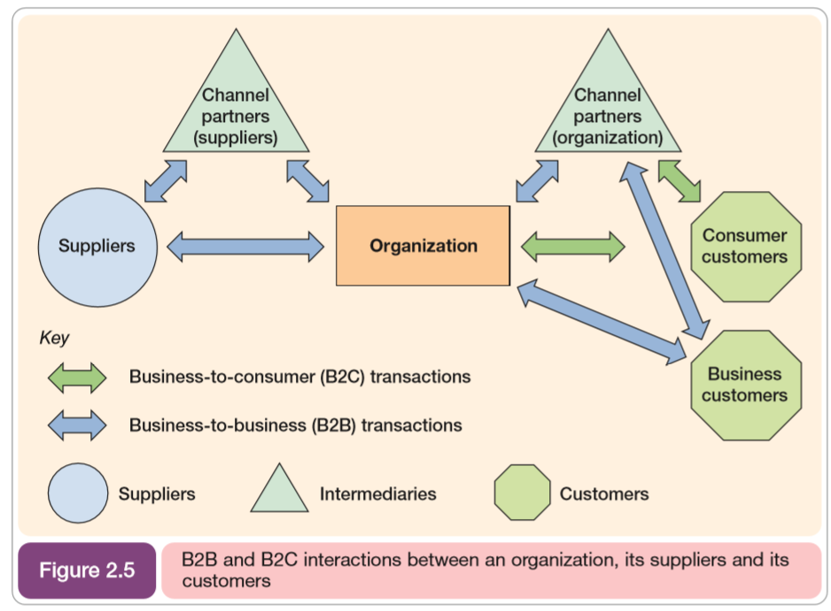
Online Marketplace Analysis
The relationship between a company and its channel partners shown in Figure 2.5 can be dramatically altered by the opportunities afforded by the Internet. This occurs because the Internet offers a means of bypassing some of the channel partners. This process is known as disintermediation or ‘ cutting out the middleman’.

Slide 19
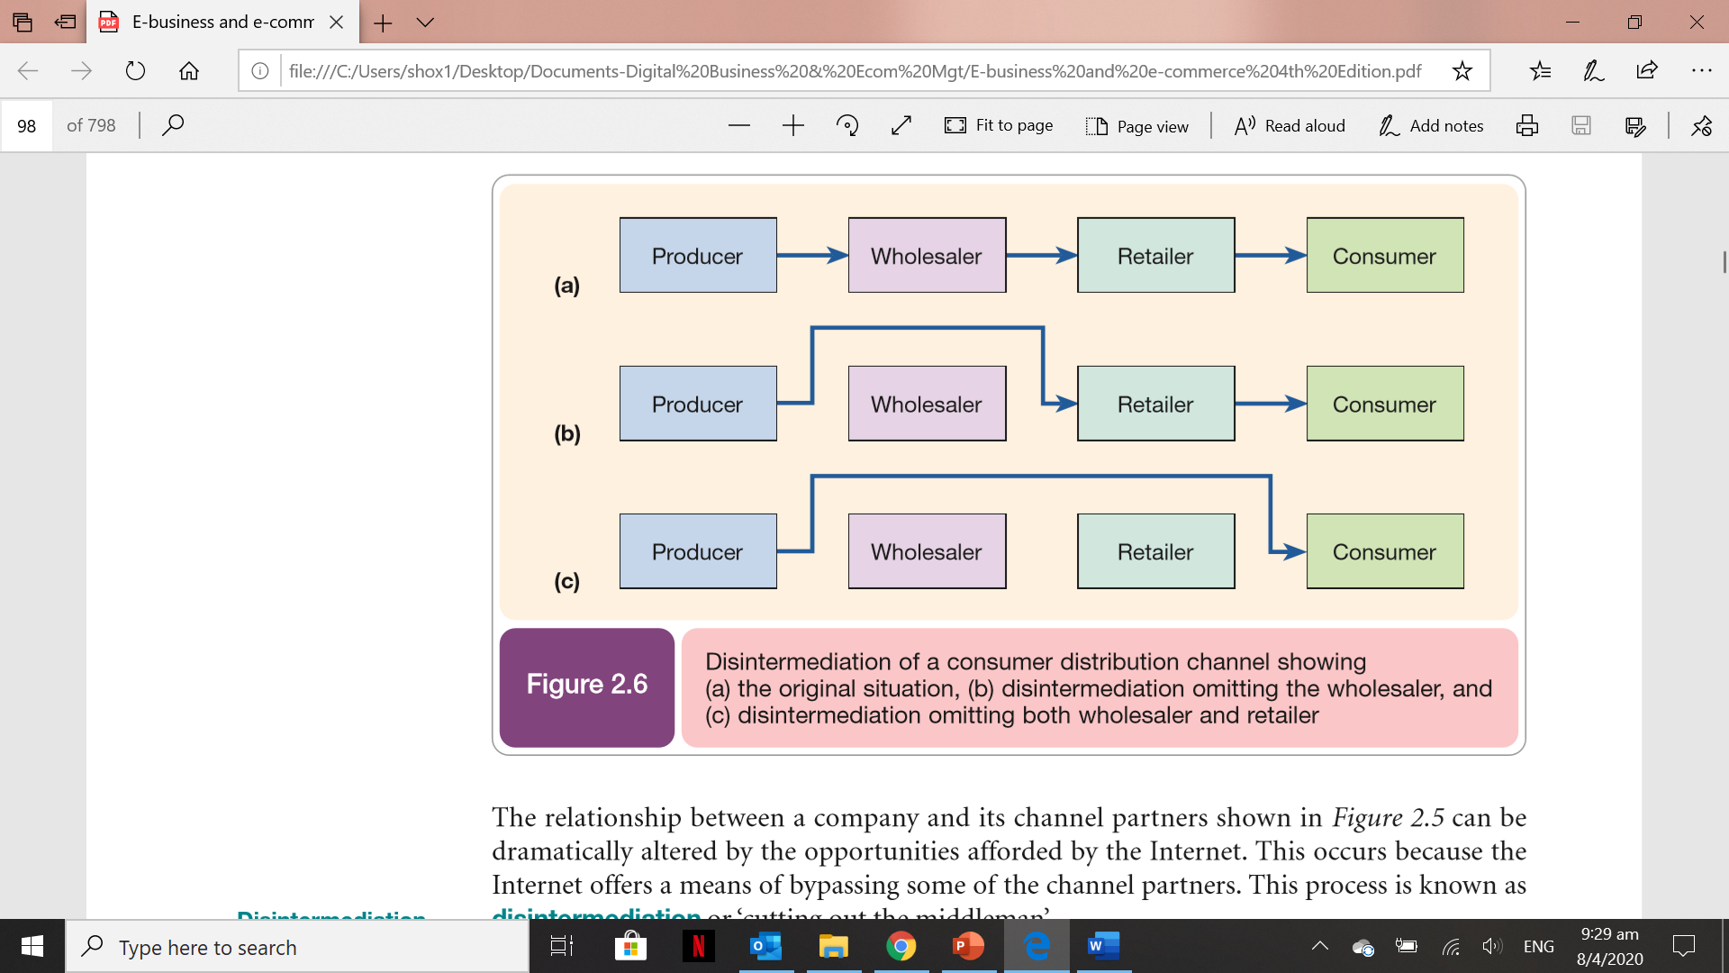
Online Marketplace Analysis
Figure 2.6 illustrates disintermediation in a graphical form for a simplified retail channel. Further intermediaries such as additional distributors may occur in a B2B market.

Slide 20
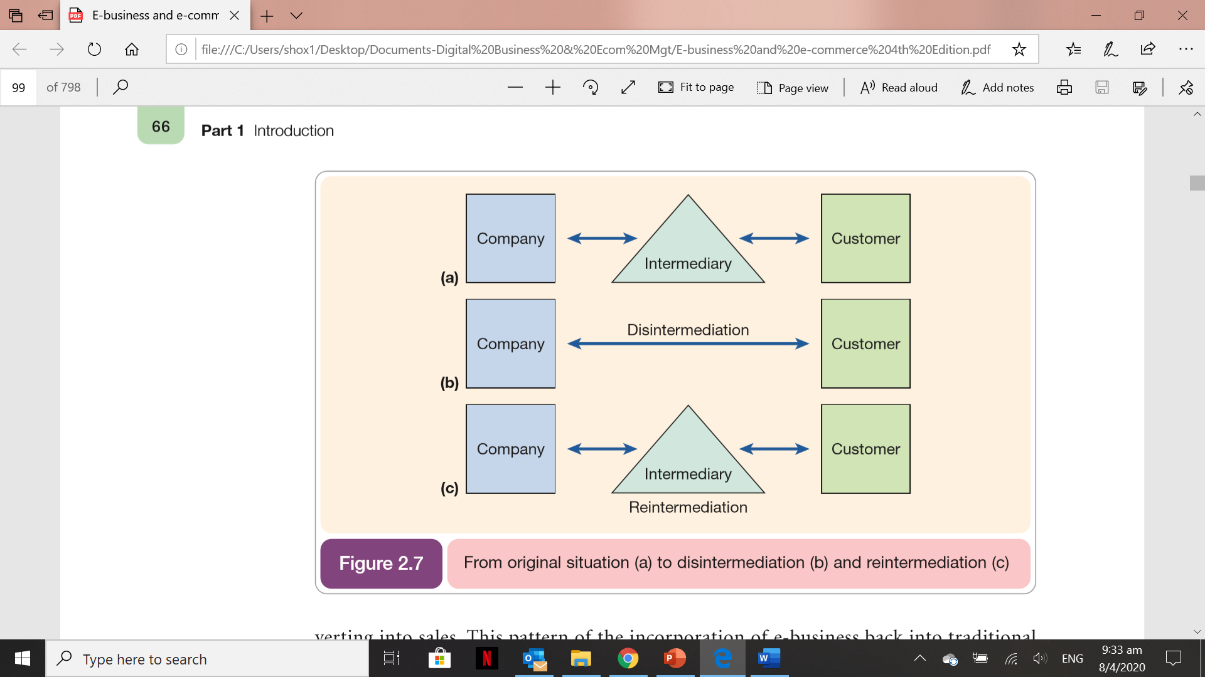
Online Marketplace Analysis
Although disintermediation has occurred, reintermediation is perhaps a more significant phenomenon resulting from Internet-based communications

Slide 21
Activity 2.5
Refer to your book for Activity 2.5

Slide 22

Location of Trading in a marketplace
While traditional marketplaces have a physical location, an Internet-based market has no physical presence – it is a virtual marketplace. electronic marketplace.
This has implications for the way in which the relationships between the different actors in the marketplace occur.

Slide 23
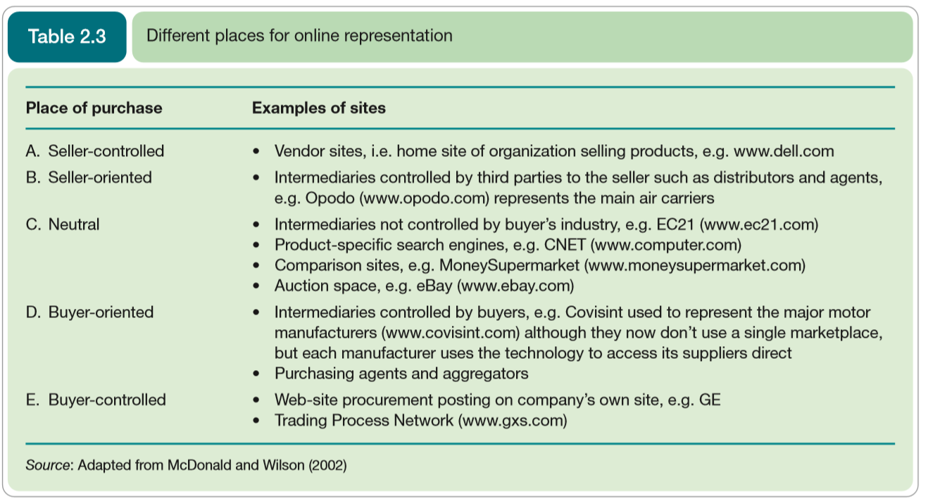
Location of Trading in a marketplace

Slide 24
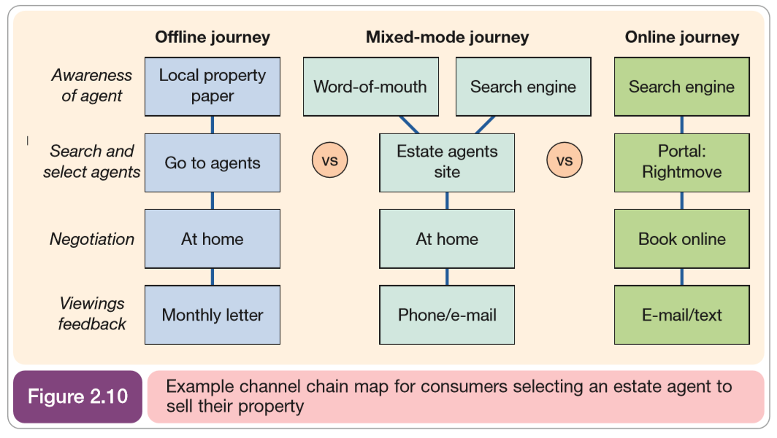
Location of Trading in a marketplace
A channel chain shows different customer journeys for customers with different channel preferences. It can be used to assess the current and future performance of these different customer journeys.

Slide 25
Location for trading in a marketplace
New intermediaries (mainly from a B2C perspective)
Directories
Search Engines
Malls
Virtual resellers
Financial Intermediaries
Forums
Evaluators
Intermediaries varies in scope and services they offer. It is useful, in particular for marketers to understand these type since they act as a checklist for how their companies can be represented on the different types of intermediaries, online publishers and media owners.

Slide 26
Activity 2.6
Refer to your book for Activity 2.6

Slide 27

Business Models for E-commerce
Defining a clear online business model is essential for a new start-up online business to be successful.
Businesses should think how to redefine and/or refine their business or add new services to their offerings in light of the new opportunities made possible by the Internet.

Slide 28
Business Model Canvas (by Osterwald and Pigneur)
Customer Segments
Customer Relationship
Channels
Key Partners
Value Propositions
Resources
Cost Structure
Revenue Stream

Slide 29
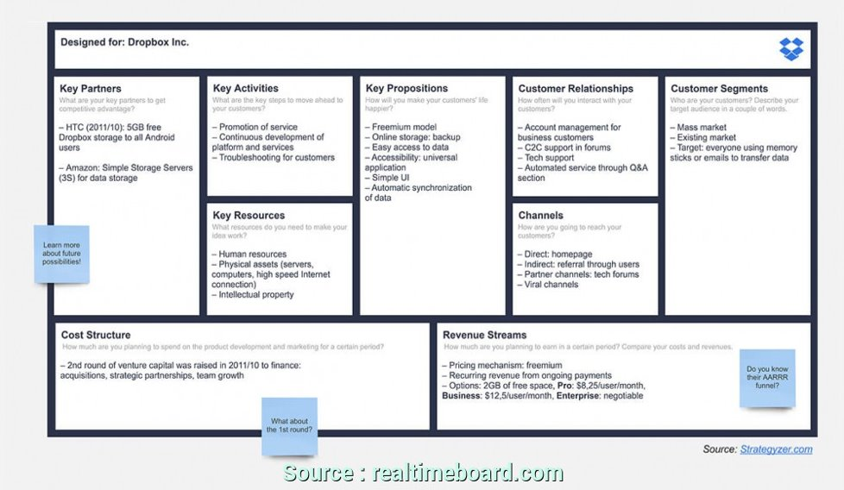
Business Model Canvas Example

Slide 30
Activity 2.7
Refer to your book for Activity 2.7

Slide 31
Revenue Models
Describe different techniques for organizations/companies to generate income.
For existing companies, revenue models are mainly based upon sales of product and services.

Slide 32
Revenue Models
CPM (Cost-Per-Thousand) display Advertising on-sites
CPC (Cost-Per-Click) Advertising on-sites
Sponsorship of site sections or content types
Affiliate revenue (CPA, could be CPC)
Transaction Fee Revenue
Subscription access to content or service
Pay-per-view access to documents
Subscriber data access for e-mail marketing

Slide 33
Calculating Revenue for an online business
Number and size ad units
Capacity to sell advertising
Fee levels negotiated for different advertising models
Traffic volumes
Visitor engagement

Slide 34
Activity 2.8
Refer to your book for Activity 2.8

Slide 35
Assessing Online Businesses
As with all new companies, it is difficult for investors to assess the long-term sustainability of start-ups.
There are number of approaches that can be used to assess the success and sustainability of these companies.

Slide 36
Assessing Online Business
Critical factors to model to consider:
The cost of Acquiring customers through marketing
The contribution margin per customer (before acquisition cost)
The average annual revenues per year for customers and other revenues such as banner advertising and affiliate revenues.
The total number of customers
The customer churn rate (* Churn rate is the proportion of customers (typically subscribers) that no longer purchase a company’s products in a time period)

Slide 37
Assessing Online Business (Six Criteria – 1 Concept)
This describes the strength of the business model. It includes:
potential to generate revenue including the size of the market targeted
superior “customer value”, in other words how well the value proposition of the service is differential from that of competitors
first-mover advantage (less easy to achieve today)

Slide 38
Assessing Online Business (Six Criteria – 2 Innovation)
Extent to which the business model merely imitates existing real-world or online models.
Note that imitation is not necessarily a problem if it is applied to a different market or audience or if the experience is superior and positive word-of-mouth is generated

Slide 39
Assessing Online Business (Six Criteria – 3 Execution)
Aspect of execution that can be seen to have failed for some companies are:
Promotion
Performance, availability and security
Fulfilment

Slide 40
Assessing Online Business (Six Criteria – 4 Traffic)
Number of Visitors
Number of Pages Visitors Visited
Number of transactions Visitors made
Which controls the online ad revenues

Slide 41
Assessing Online Business (Six Criteria – 5 Financing)
Ability of the company to attract venture capital or other funding to help execute the idea.
It is particularly important given the cost of promoting these new concepts.

Slide 42
Assessing Online Business (Six Criteria – 6 Profile)
Ability of the company to generate favorable publicity and to create awareness within its target market.

Slide 43
Activity 2.9
Refer to your book for Activity 2.9

Slide 44
Self-Assessment Questions
Refer to Activity booklet for questions which will help you review the topics covered in this lesson.

